Slide 1






Amazon Web Services
Introduction & New Features Announced at AWS re:Invent 2013
FIN talk
Robert Greiner
Jeff Townes
March 20, 2014

Slide 2



CHAPTER
1
Cloud, Now.
_

Slide 3
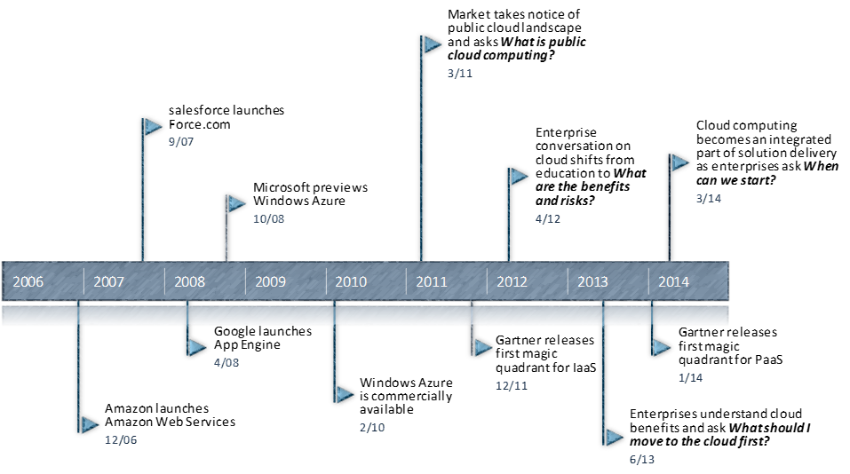
Cloud computing is evolving from “experiment” to “enterprise must”

Slide 4
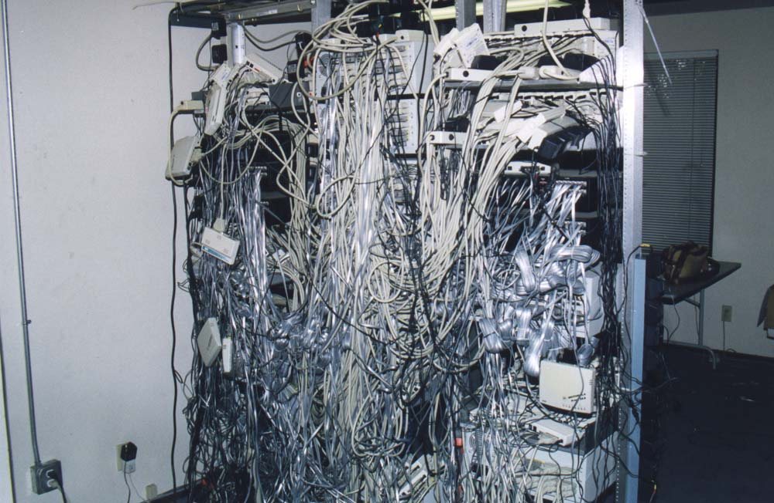



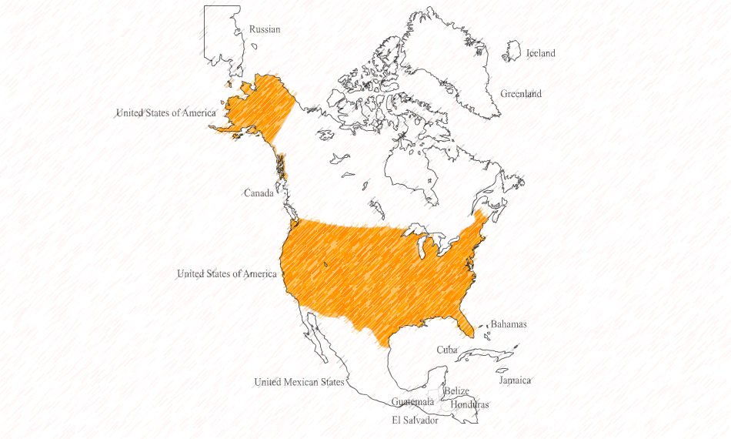
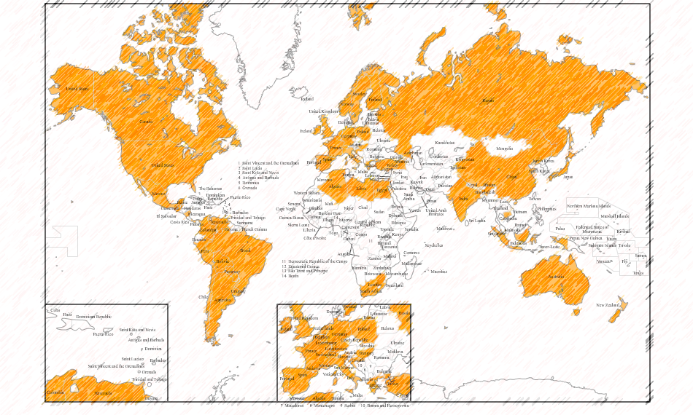
Sidebar: What is cloud computing?
Turn This…
…Into This
And Apps Here…
…Into Apps Here

Slide 5

Cloud development offers unique benefits to our teams and clients
Speed
Scalability & Global Reach
Interoperability
Security & Compliance
Happiness
Forrester: Cloud Developers Happier, More Adventurous Than Non-Cloud Developers
-Aug. 15, 2013
http://www.forrester.com/Who+Are+Enterprise+Cloud+Developers/fulltext/-/E-RES101361

Slide 6
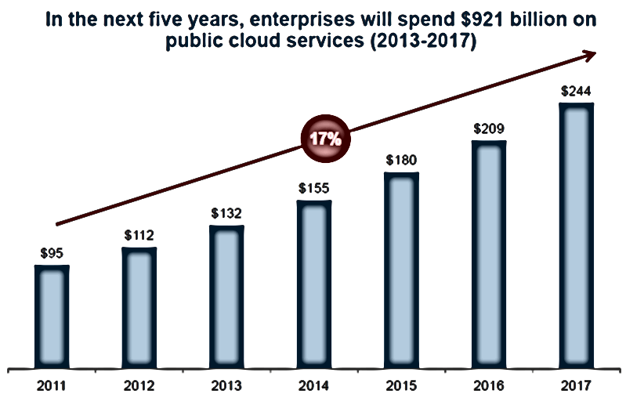
Cloud is growing at five times the rate of the IT industry as a whole
Clients Can’t Keep Pace
Source: Gartner, October 2013

Slide 7
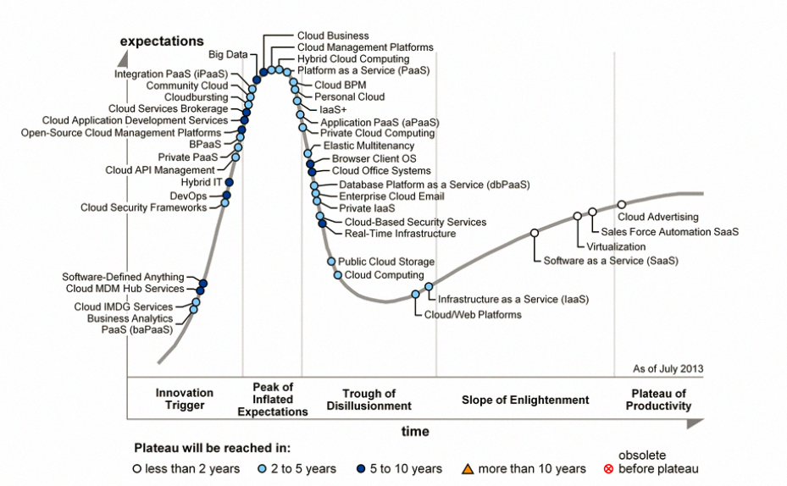
Vendors and analysts are flooding clients with opinions and predictions
Example: Gartner Hype Cycle for Cloud
Keyword:
HYPE

Slide 8
It’s up to Pariveda to serve as the voice of experience and reason in the Dallas market
_
Actually, it’s up to you.

Slide 9

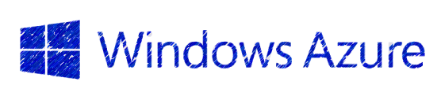


Are you informed and ready to implement new patterns and deliver cloud solutions?
… and many, many other cloud platforms

Slide 10
Comparing Application Platforms
Corporate Data Center (Physical Infrastructure / Private Cloud)
Infrastructure as a Service (IaaS)
Managed by Our Clients
Platform as a Service
(PaaS)
Applications
Managed by Our Clients
Applications
Applications
Data
Data
Data
Managed by Our Clients
Runtime
Runtime
Runtime
Middleware
Middleware
Middleware
Managed by cloud vendor
O/S
O/S
Managed by cloud vendor
O/S
Virtualization
Virtualization
Virtualization
Servers
Servers
Servers
Storage
Storage
Storage
Networking
Networking
Networking
Automation & Rapid Deployment
Flexibility & Control

Slide 11


So, AWS is IaaS and Azure is PaaS, right?
Infrastructure as a Service (IaaS)
Platform as a Service
(PaaS)
Too simplistic

Slide 12
We should advocate a better way to evaluate cloud service offerings
 | Compute Services | Storage Services | Networking Services | Application Services | Data & Analytics Services | Integration Services | Deployment & Management Services | Access Control Services
Primitive Service Offering
Managed Service Offering
Primitive: you manage infrastructure
Managed: vendor manages infrastructure
do
Vendors can^ have offerings in both groups

Slide 13
CHAPTER
2
AWS Overview
the “how”
Notes:
We’ve talked about the “why”, now let’s talk about the “how”
This next chapter is meant to give you a comprehensive overview of everything AWS has to offer, so you know where to look when – not if – you get staffed on a cloud project
I think you will be surprised at the robust set of services AWS offers
You will probably see a service or two that you could use today on your project
Keep in mind that AWS’ real power comes when you start combining multiple services

Slide 14


Cloud Matters

Slide 15




Compute Services
Elastic Compute Cloud (EC2)
VMs in the cloud
Full Control over your VMs
Remote Desktop
Only pay for what you use!
New servers in minutes, not months
Auto Scaling
Automatically add and remove EC2 instances based on demand
Saves on compute costs
Seamlessly handle demand spikes
Requires existing Amazon Machine Image
WorkSpaces – New!
Desktop VMs in the cloud!
Provisioned and managed in a single location
Consistent experience on any device
All company data resides in a single, controlled location
Notes:
Helps your business focus on what differentiates them in the marketplace
EC2 makes it very easy to “lift and shift” existing datacenters to the cloud
Don’t have to worry about infrastructure, networking, DR, real estate, or hiring people to manage your datacenter
Companies are cropping up with technologies that would have been impossible in the past due to heavy infrastructure demands
- Hardware / Software solutions that transfer terabytes of data per user
Allow services companies to meet their current customer demands without having to worry about investing in infrastructure
AWS Modular Data Center - http://www.datacenterknowledge.com/wp-content/uploads/2011/06/amazon-perdix.jpg

Slide 16
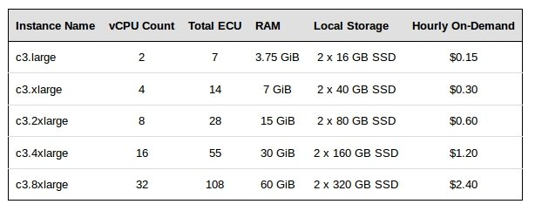
New EC2 Instances
New i2 Instances – IOPS Optimized
Added 4XL and 8XL instances
Up to 350k IOPS on the 8XL instance
SSD based
Perfect for Big Data, NoSQL, and clustered systems
New C3 Instance Type – Compute Optimized
Highest processor performance on EC2
2.8 GHz “Ivy Bridge”
SSD based
2 – 32 Cores
One c3.8xlarge instance has more processing power than 40 Lenovo W520 Laptops

Slide 17

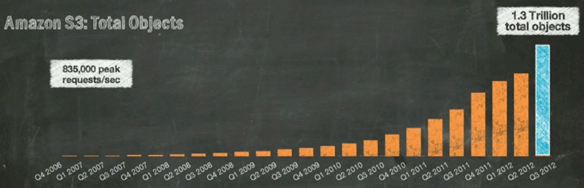


Storage Services
Simple Storage Service (S3)
High durability and availability data store
Read / Write / Delete objects
Files from 1 Byte to 5 Terabytes
REST and SOAP interfaces
PCI and HIPAA compliant
Automatic archiving
Glacier
Low-cost and durable data archive - Digital Preservation
Grows with your application - No storage limits
The 2014 version of Magnetic Tapes + Offsite Storage
Elastic Block Store (EBS)
Persistent block-level storage volumes for your EC2 instances
Replicated within Availability Zone
4,000 IOPS

Slide 18

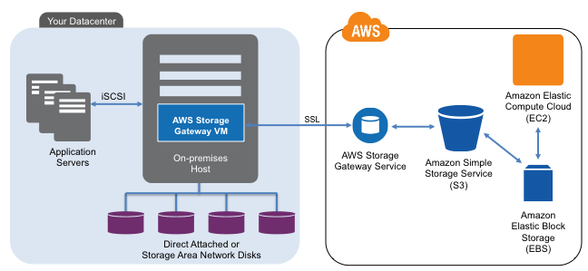

Storage Services
Hybrid Cloud
Storage Gateway
Connect on-premesis software with cloud storage
VM you install in your data center
Mount as iSCSI device in your application
Store directly in S3 or Asynchronously sync
AWS Import/Export - 2014 Sneaker Net
Physically ship devices to AWS for data load or extraction
Disaster Recovery / Offsite Backup / Distribution

Slide 19


Networking Services
Elastic Load Balancing
Automatically distributes traffic across your EC2 instances
Greater fault tolerance
Avoids unhealthy EC2 Instances
Advanced Monitoring / Logging
Set up manually through AWS Management Console
Virtual Private Cloud (VPC)
Provision a logically isolated section of AWS
Launch AWS resources in a network you define
Complete control over virtual networking environment
IP address range
Subnets
Route Tables
Network Gateways

Slide 20

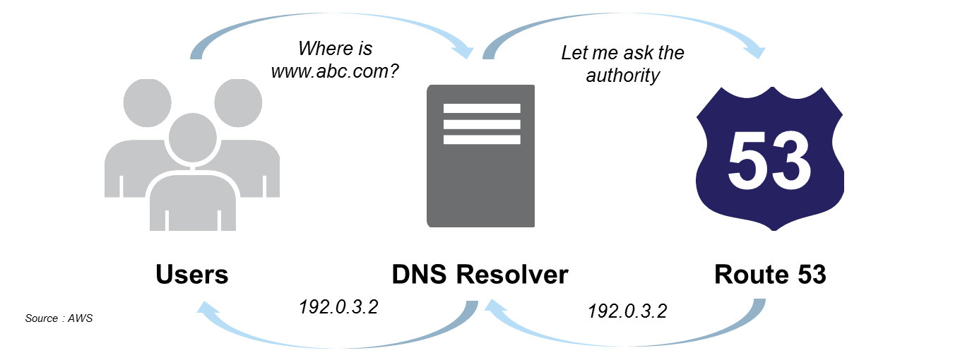

Networking Services
Route 53
DNS Service
Reliable and cost effective way to route web users
www.parivedasolutions.com -> 64.5.52.124
Direct Connect
Dedicated network connection: on-premises to AWS
Private connectivity between AWS and your datacenter
Lowers bandwidth costs
Connection exists outside of ISP
Good for large datasets
Worldwide Direct Connect locations

Slide 21
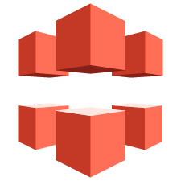

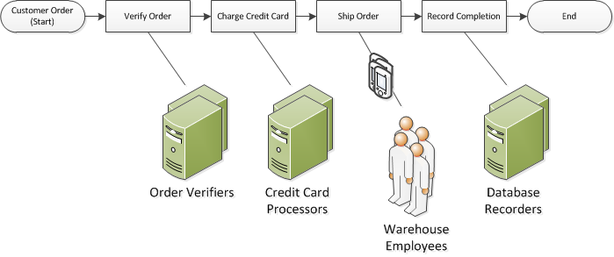
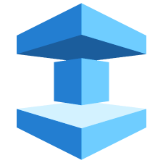
Application Services
CloudFront
Content delivery service
Store data in AWS, create distribution, use distribution URL
Simple Workflow
Task coordination and state management service
Execution of activities that can run asynchronously
Coordinate, audit, and scale applications across multiple machines
ElastiCache
In-memory cache in the cloud
Deploy, operate, and scale
Memcache or Redis

Slide 22

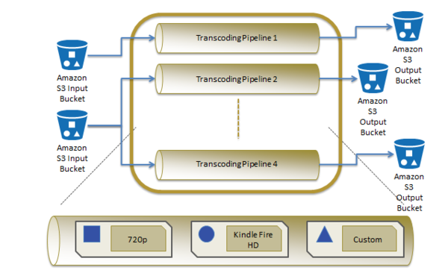

Application Services
Elastic Transcoder
Media transcoder in the cloud
Convert media files to be compatible with other devices
Upload source media file and convert to deliverable types
No up-front hardware investment for expensive workflows
No expensive transcoding software required!
Login and Pay with Amazon
Flexible API to allow authentication and payments through Amazon
Set of widgets and APIs to integrate with backend systems
Reduce registration friction – use existing Amazon account

Slide 23

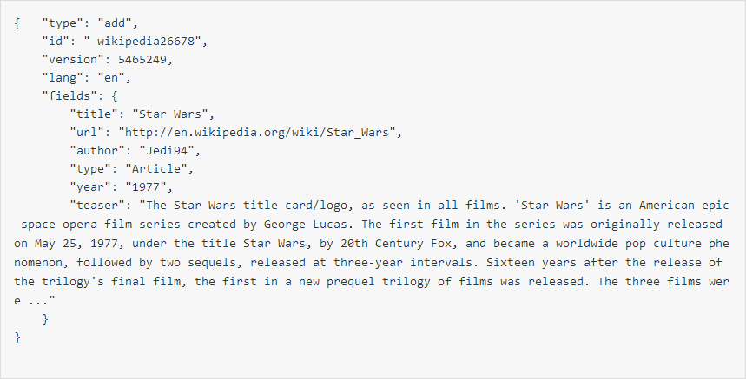

Application Services
Cloud Search
Easily set-up, manage, and scale a search solution for your website
JSON – Search Data Format results
Search large data collections
Websites
Documents
Forum Posts
Configure search domains
Upload documents for indexing
Submit search requests
AppStream – New!
Stream resource intensive applications and games from the cloud
Deploy application to AWS infrastructure
Stream output to mass-market devices
Stream all or parts of your application
Rich User Experience
vs.
Wide Audience

Slide 24


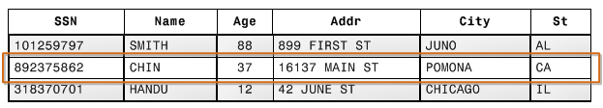
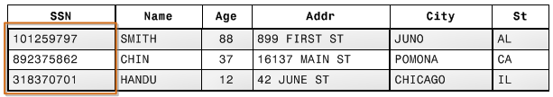
Data Services
Relational Database Service (RDS)
Managed relational database instances
Most traditional approach to data management
MySQL, Oracle, SQL Server, PostgreSQL on your own instance
Import existing application data to a new RDS instance
Redshift
Data Warehouse Service – 1/10 the cost of traditional data warehouse
Easily and rapidly analyze Petabytes of data
Compatible with popular BI tools
Columnar Storage – automatically stores columns in data blocks
Optimized for analytical queries
Reduces overall disk I/O
=>

Slide 25

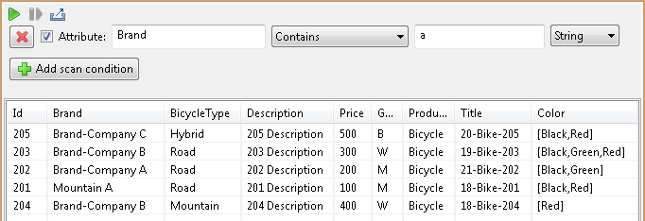
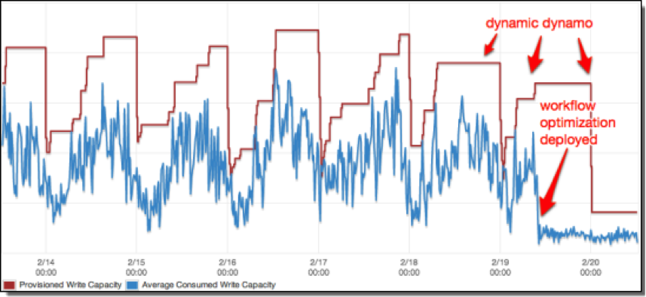

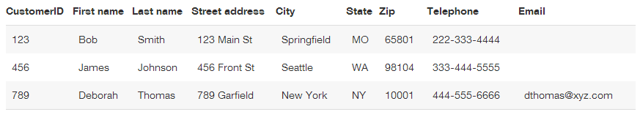
Data Services
DynamoDB
NoSQL Database Service
Predictable performance
Auto scaling with Dynamic DynamoDB
Scalable and Performant
SimpleDB
Non-relational data store – “Spreadsheet in the cloud”
Web services interface to create, store, and query data
Automatic indexing – good for smaller workloads
Key/Value pairs
PUT (item, 123), (First name, Bob),…
Simple and Flexible

Slide 26



Analytics Services
Elastic Map Reduce
Managed data processing using Hadoop
Analyze data across multiple data stores
Add and remove capacity at any time
Data Pipeline
Move data between AWS compute and storage services
Create complex data processing workflows
Scheduling, execution, and retry logic
Connect to on-premises data sources
Automated reporting, analysis, and logging
Kinesis – New!
Real-time processing of data streams at massive scale
Integrates with other AWS services
100+ TB/hr
100,000+ sourcees

Slide 27



Integration Services
Simple Queue Service
Fast, reliable, scalable, fully-managed queue service
Add messages to the queue to be processed later
(Application Messaging)
Simple Email Service
Cost-effective outbound only email service
Same service Amazon.com uses for its customer base
Multiple email types
Transactional
Marketing messages
High-quality content
(Customer Messaging)
Simple Notification Service
Deliver notifications via SMS or Email to any HTTP endpoint
Push messages to mobile devices
iOS
Android
Kindle Fire
(Mobile Messaging)

Slide 28

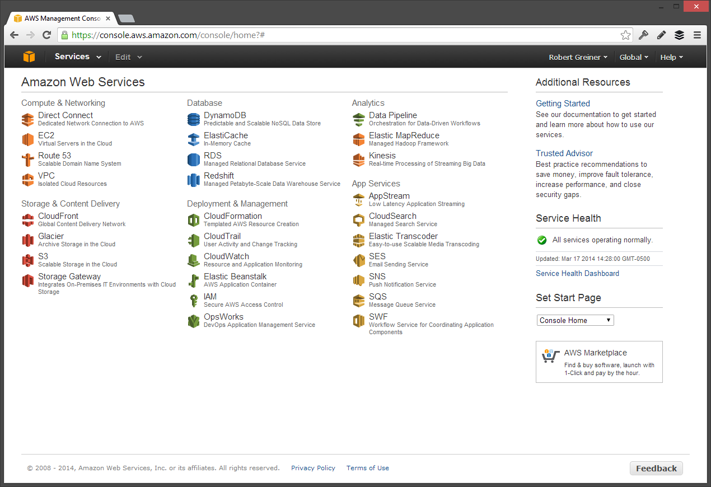
Deploy and Manage
AWS Management Console
Access all AWS services in one place
Deploy applications and monitor health
AWS Account administration, billing, usage, etc.

Slide 29



Deploy and Manage
Elastic Beanstalk
Deploy and manage applications in AWS
PaaS like – you still retain full control
You upload your application
Elastic Beanstalk will:
Provision capacity and load balancing
Configure auto scaling
Setup application health monitoring
OpsWorks
DevOps model and manage the entire application
Pre-built templates
Custom Chef recipes
Cloud Formation
Create and manage a collection of AWS resources
Provision and update collections in a predictable way
One template – Many deployments (JSON config)

Slide 30



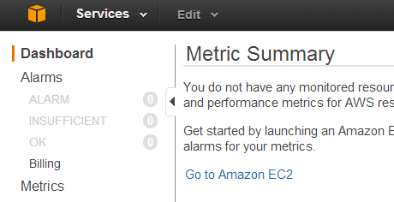
Deploy and Manage
Cloud Hardware Security Module
Protect sensitive data within the AWS platform
Used for rigorous contractual or regulatory requirements
Protect and store cryptographic keys
CloudTrail
Records AWS API calls and delivers logs to you
Identity, time, source IP, request parameters, and response
Increase visibility with inexpensive log storage
Cloud Watch
Monitoring AWS cloud resources
Collect and track metrics
Gain usage and billing insight
Enables quick response times to ensure uptime
Graphs and statistics built-in for any metric

Slide 31

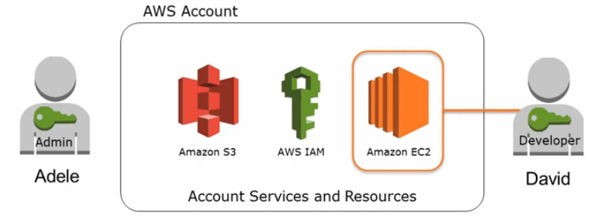
Access Control Services
Identity & Access Management (IAM)
Securely control access to AWS services and resources
Create AWS users and groups
Assign permissions to users and groups
Compatible with Multi Factor Authentication
Assign temporary credentials
Works with 3rd party Identity Providers
Active Directory
Google
Facebook
Login and Pay with Amazon
Flexible API to allow authentication and payments through Amazon
Set of widgets and APIs to integrate with backend systems
Reduce registration friction – use existing Amazon account

Slide 32
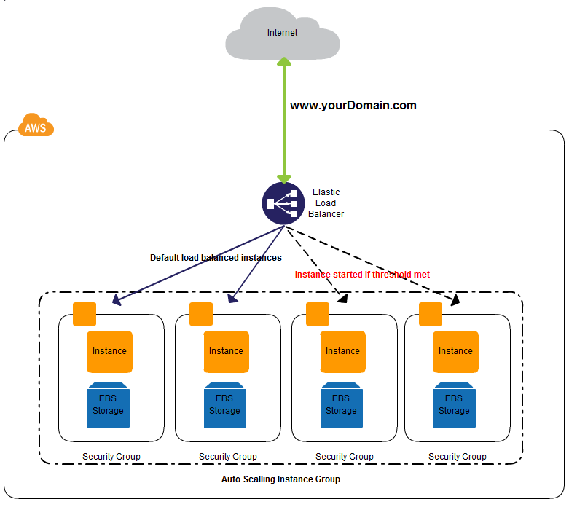
Putting it all together
Load balanced, auto- scaling application with Amazon EC2
Notes:
http://creately.com/diagram/example/h4jacmks1/Load+Balanced+Auto+scalling+web+application+cluster+with+Amazon+EC2

Slide 33
Amazon Web Services
 | Compute Services | Storage Services | Networking Services | Application Services | Data & Analytics Services | Integration Services | Deployment & Management Services | Access Control Services
Primitive Service Offering | Elastic Compute Cloud (EC2) Auto-Scaling (Requires Existing AMI) | Glacier Import /Export Storage Gateway | Virtual Private Cloud (VPC) Elastic Load Balancing Route 53 Direct Connect | N/A | N/A | N/A | Cloud Hardware Security Module | Identity & Access Mgmt.
Managed Service Offering | Work Spaces | Elastic Block Store Simple Storage Service (S3) | N/A | AppStream CloudFront (Content Delivery) ElastiCache Cloud Search Elastic Transcoder Simple Workflow Login and Pay with Amazon | Relational Database Service DynamoDB Redshift Elastic Map Reduce Kinesis Data Pipeline Simple DB | Simple Queue Service Simple Email Service Simple Notification Service | AWS Mgmt. Console CloudTrail Cloud Watch Elastic Beanstalk Cloud Formation OpsWorks | Login and Pay with Amazon

Slide 34
The cloud lets you focus on what differentiates you in the marketplace.
Not, servers, networking, real-estate, etc.

Slide 35
CHAPTER
3
AWS vs. Azure

